Slide 1
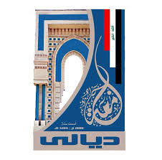
Electrical Circuit-I
7th Lecture

